Slide 1
Problems and prospects of Arid legumes for Self Sufficiency
D. Kumar
Arid Legumes Consultant,
Secretary, Indian Arid legumes society
E Mail : dkumarcazri@gmail.com
Mob. No 91 9314008627
Presented during Group meeting organized by ICAR-ATARI, Jodhpur for 26-27 July 2018-19

Slide 2
Securities
Security means encountering the defects and demerits through legumes , inherited in the arid farming systems
Security means thwarting threats and challenges emanating from the rapidly changing climates
Sufficiency against nutritional deficiency, malnutrition and poverty ridden life cycles of the peasants and farmers
Efforts for additional income adding towards system diversity ,security against nutritionally poor soils
For ensuring stability and traceability in production system
Sustaining and binding faith with agriculture enterprise
Helping considering agriculture as small industry by the small holders

Slide 3
Need of Agricultural System through legumes
In view of versatility of problems, solution lies in a system which can address :
Taming drought ; sustaining soil fertility and its productivity ;system productivity with traceability; ensuring nutritional and malnutrition security to the human and livestock population; providing the guarantee of lessening system failure; being convent and cheap ; lastly facing global warming .
Thus, diversified legumes based farming system, shared by livestock raring will suite to rain fed situations ; and protected agriculture to export oriented assured agriculture .

Slide 4
Some reasons for pulse priority
Pulses use less water than other protein sources
Pulses use less fertilizer
Pulses improve soil health
Pulses improve health
Pulses have low carbon foot print
Pulses leave more water in the soil than other crops
Pulses use soil bacteria to draw nitrogen from the air
Pulses feed microbes which enrich the soil
Pulses are source of low fat protein ,vitamins and fibers
Pulses are resilient in face climate change ,particularly rising temperature

Slide 5
Production of protein from different sources ( gallon of water for one pond protein)
Beef 1857 Gallons of water
Pork 756 Gallons of water
Chicken 469 Gallons of water
Pea nuts 368 Gallons of water
Soy beans 216 Gallons of water
Pulses 43 Gallons of water
From ICARDA

Slide 6
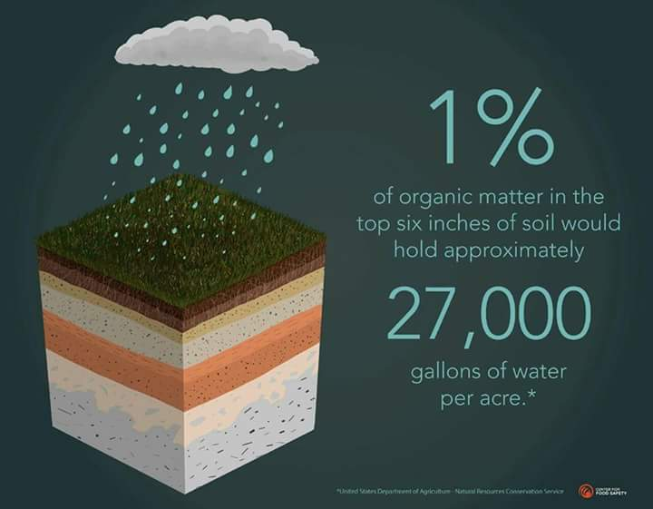
Organic carbon and water conservation

Slide 7
General
World over ,each of fourth person ,is suffering from mal nutrition,795 million people are suffering from hunger.
Enhanced stability in food and nutritional chain will prove successful in lowering hunger and mal nutrition.
In coming 20 years , additionally, 20 million stomach need to be fed ,in other words ,world population by 2050 would be more than 9 billion
Legumes are known to fulfill the dietary requirements of the same ,particularly ,maximization of vegetable proteins, minerals, amino acids( lysine & Lucien),whereas cereals are poor in the same.

Slide 8
Uf Uses of Moong bean Pulseof m
One bowl moong bean pulse contains hardly 100 calories
Given to growing children for growth
Helps reduce wt and reduces calorie intake
Postpones hunger for longer time
B. P. controller ,reduces cholesterol level
Reduces adverse effects of Na
Redresses strength after weakness
If introduces in vegetable diets reduces Anemia
Its Khichri overcomes the problem of indigestion

Slide 9
Introductory---
Socially ,economically and environmentally stable agriculture is required ;there is need to adopt cropping system following markets needs and supply chain.
Diversity in agriculture and additional income from pulses may bring prosperity in rain fed agriculture.
The need is felt to join nutritional security with agriculture.
The youth are understood hope of world future agriculture.
Agriculture needs digital solution.
The need of the hour is to join all environmental factors, agriculture products, agriculture thoughts and agriculture philosophy.
Legumes and pulses are understood as social meat, those poor can not purchase meat , consume pulses.
Enhancement in pulse productivity, is essential to bring about stability in world agriculture and future food requirements

Slide 10
Food and Nutritional Security
Pulses only can provide solutions for mal- nutrition and food security to poor farmers and common men and file.
By the consumption of beans , reducing iron deficiency in blood and lowering cholesterol in blood could be achieved.
Similarly Tepary bean is also known for more iron and less glysine index, may reduce the adverse effects of sugar in human body.
Tepary bean may supplement black and white beans. On the contrary Pinto bean is known for poor iron contents.
Certain anti nutritional factors, indigestible factors and certain harmful metabolites, like, trypsine inhibitors ,saponians, polyose need to be addressed.
Hyacinth bean (A-52 ,Sabawel) has high Methionine cont (5.2-5.5%)
Winged bean (Hefei 85.6) has high oil (14.4%),and protein content (37.6 %).

Slide 11
Seed
Seed is a vehicle for spread ,life span and promising productivity of the system.
56 %seed availability is done by local market,26 % by the self stock,17 % by agriculture dealer, and 2 % is done by other sources
60– 65 % new varieties are being developed by NGOs.
The need is felt to argue and discuss the utility and benefits of new varieties and same must be published in papers and periodicals .
Agricultural and seed distribution related sources must be extended to interiors of rural belts .
The exchange of seed at the small shops and social levels need to be increased
Availability at the village and at individual leve ,l groups , need to be encouraged.

Slide 12
Microbial Fertilizers
A strong coctail amongst micro- organisms and microbes is advocated. In situation, the number of these organism reaches above 10 -3to10 -6\ g ;and addition of 8-10 % P , grain yield of cowpea could be increased up to 2000 kg\ha.
For individual availability ,application of both N & P fertilizers is essential.
Treatment with local strains was advocated as same have antagonistic effects.
Seed treatment with Rhizobium culture could reduce requirement of N.
Specific Rhizobium culture must be treated with specific variety of pulse crops.
Yield increment could be realized to the extent of 30-35 % ,if combined treatment is done with N & P cultures. These activities are more suited to small and marginal farmers.
Joint treatment with these cultures ,leads to improvement in soil structure, plant weight , its produce and quality.

Slide 13
Pulse Production
It is reported that farmers yield is 3-4 times less than Institution yield.
Pulses have lot of adaptation elasticity and can be adjusted with any major crop or the system.
Cotton-cowpea – maize is most useful crop sequence in African countries.
When pulse crop is included in any crop rotation ,it breaks down weed and disease cycle, and improves soil fertility .
Good quality seed ,perfect planting method and timely weed removal can accelerate grain yield by about 50 %.
Cow pea is cultivated in African zone in rain fall situation of 400 to 1200 mm, showing wide adaptation.
Cow pea is cultivated in 14.7 m ha and produces 7.2 lakh ton annually. Optimum dose of fertility for this crop in Africa is 20 kg N,40 kg P ,10 kg K and 10 kg S.

Slide 14
Pulse production----
Pigeon peas and cow pea when intercropped with maize ,the availability of protein and lysine from maize is increased. It is essential because African consume only 4-5 g protein per day only.
Another important pulse in African zone is bean .In Kenya 99 % people consume it and eat 3-4 times in a week. This crop ,however requires more water and takes quite long time to mature and production cost is higher( @ $ 1.5 per kg grain ).Some un digestible nutrients are found , its consumption leads to increment in height and weight of infants.
Marama bean does not flower up to 12- 15 months, can survive in the field even up to 10 yrs, is cultivated with 100 – 150 mm rain fall ,produces 400 – 500 kg/ha. This pulse is most suited to prevent soil erosion.

Slide 15

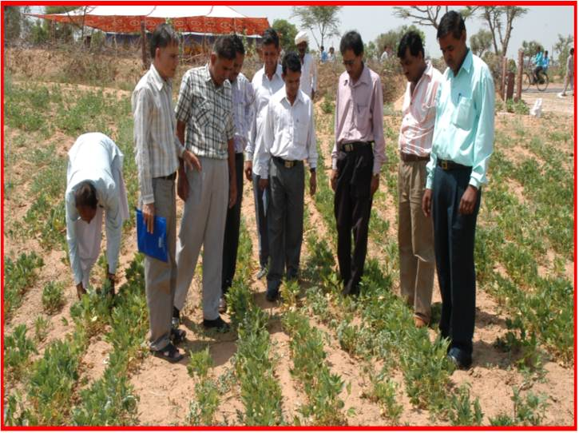
CAZRI Moth-3 has become success story
during Kharif-2009.
Location of trial: Mr. Goverdhan Ram
in Neora road (Jod)
Conditions: Rainfall 140 mm,
34 to 35 days, temp. 40-42°c
Inputs: only pure seeds of improved
c.v. and interval between two rains
Crop/Var/ Inter row spacing | Total grain yield (kg/ha.) | Benefit (Rs.) | C:B
Moth (CZM-3) :40cm | 435 | +11450 | 1 : 2.92
Moth (RMO-435) :20 cm | 100 | -1950 | 1 : 0.67
Guar (RGC-1066) :20cm | 150 | -3250 | 1 :0.45
Bajra (CZP-9802) :20 cm | 175 | -4000 | 1 : 0.03
Notes:
15
-+-+-+
.
+

Slide 16

Root growth of moth bean during dry season of 2002 at 45 DoS

Slide 17
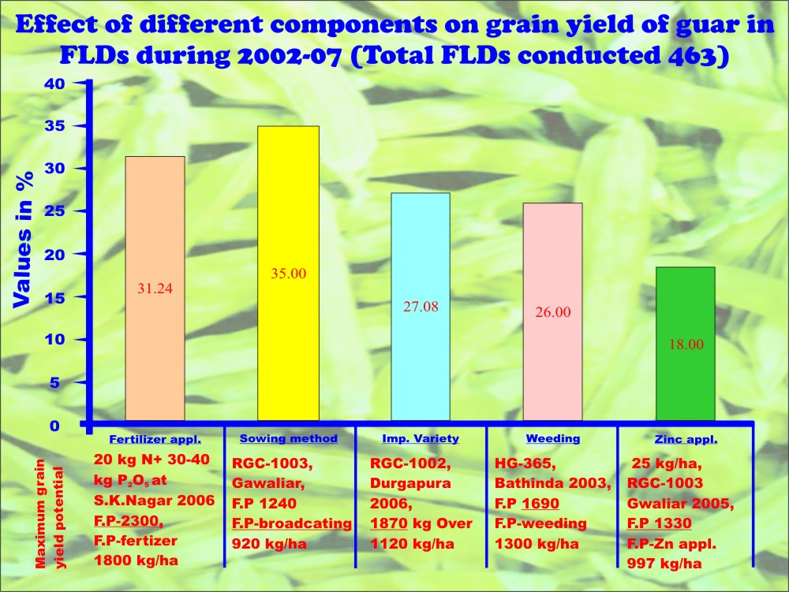
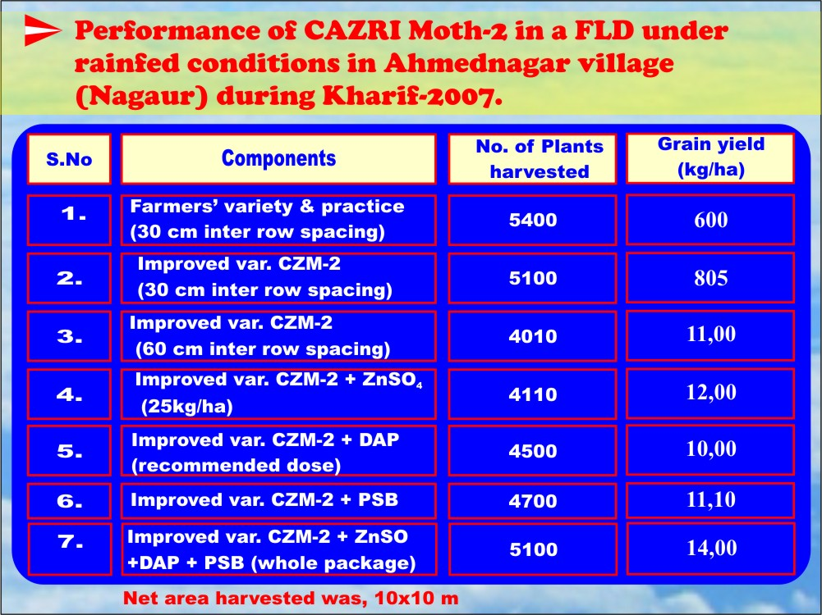

Slide 18
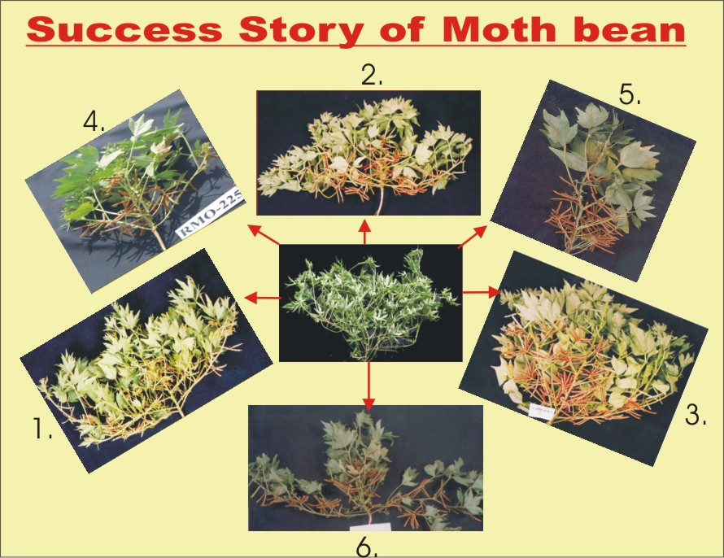

Slide 19
Guar for fodder ,feed and concentrate
Guar provides nutritious fodder and concentrate to the livestock
The green forage (dry basis) contains :
16 % Crude protein,
46 % Total digestible nitrogen (TDN)
11-12 % Digestible crude protein
60 % Dry matter digestibility
Advisable to feed guar at 50 % flowering stage
The DM intake of fodder is high (2.50-3.50 kg/100kg body wt.)
Guar provides good hay and makes nutritious silage when mixed with wheat straw.

Slide 20
Guar Korma and Churi have low market values
These are largely fed to ruminants(cow, bufallow ,camel, sheep ,goats),not suitable to mono gastric animals(pig, poultry ,aqua ,human beings)
The reasons are:
Undesirable odor
Residual guar gum
Presence of try sin inhibitors
Other toxic substances: Poly phenols ,saponians, Lignins, Phytates causing substances like organic acids, Aldehydes ,Cyanogen.

Slide 21
Comparison of guar Korma with other sources( % dry basis)
Source | Crude protein | Ether Extract | Crude fat | Maximum Rate (Rs/kg) energy (kcal/kg)
Guar Korma Guar Churi Mustard Cake Soya Meal Groundnuts Extract | 48-50 35-35.5 38 45 45 | 6-6.5 3.5-4.5 0.5 0.5 0.5 | 5-7 4.0-4.5 7-8 7-7.5 10-13 | 20.0 2400 14.5 2500 16.50 2668 42.5 2700 31.0

Slide 22
Amino acid profile of meal sources
S.N.++ | Amino acids | Guar meal | Groundnuts meal | Soya meals
1 | Aspartic acid | 11.2 | 12.1 | 11.92
2 | Glutamic acid | 26.94 | 23.77 | 23.27
3 | Serine | 6.05 | 6.45 | 6.56
4 | Glycine | 6.08 | 7.66 | 4.83
5 | Histidine | 2.3 | 2.06 | 2.09
6 | Arginine | 5.23 | 4.86 | 6.41
7 | Alanine+proline | 12.1 | 11.2 | 9.3
8 | Tyrosine | 3.63 | 3.23 | 3.42
9 | Valine | 3.87 | 4.59 | 4.61
10 | Methionine | 1.27 | 1.32 | 1.44
11 | Cystine +Isoleucine+leucine | 5.5 | 6.3 | 7.0
13 | Phenylalanine | 4.49 | 5.48 | 5.51
14 | Lysine | 4.49 | 3.31 | 6.09
15 | Threonine | 6.85 | 7.58 | 7.56
Total | ---------- | 99.97 | 99.91 | 99.99

Slide 23
Improving the quality of Guar Meal
Roasting: The industries have already started producing Roasted Korma. It removes trypsin inhibitor(Trypsion is Protease inhibitor that prevents protein break down) heating reduces UDP in guar korma from RDP(Rumen degradable protein),showing better results. It also improves guar gum by hydrolyzing galactomannan. Roasting also improves palatability.
Formalin treatment: To increase the by pass value of protein for ruminants by soaking, germinating, autoclaving ,boiling ,cooking ,fermentation

Slide 24
Fig: Grain yield and gum content during kharif 2011 and summer 2012.

Slide 25
Grain yield (kg/acre) of guar demo and control plots in rain fed conditions at Bikaner in 2015
S.N. | Name of the farmer | Demo willage | Control yield | Demo yield | % increase
1 | Rameshwar Lal | Khiara | 55 | 204 | 271
2 | Ashok | Binjerwali | 50 | 152 | 204
3 | Bhanwar lal | Bawanwali | 20 | 107 | 435
4 | Jagdish | Hamera | 31 | 105 | 239
5 | Rupa Rram | Sarera | 74 | 87 | 18
6 | Mangey Ram | Dhirera | 55 | 65 | 18
7 | Meigh Singh | Rani sar | 14 | 30 | 114
8 | Pema Ram | Dudiwali | 17 | 28 | 65
9 | Rameshwar Sharma | Kharda | 18 | 25 | 39
10 | Choru ram | Rajera | 13 | 16 | 2.5
 | Mean | --- | 34.7 | 0.82

Slide 26
Tips for certain arid pulses/legumes
Moth bean : Strictly arid pulse ,requires 150-250 mm rains through 2-3 spells, may tolerate 25-40 dry days ,confined to arid region only ,suites to light textured soils, 60 days varieties are there
Guar : Arid and semi-arid legume, requires 300-600 mm rains through 4-5 spells ,tolerates 30-45 dry days ,light and good soils required (soils no barrier ), no variety with less than 90 days
Moong bean : Semi-arid pulse, requires 300-400 mm rains through 2-3 spells, suits to better textured soils, may stand well during 25-35 dry days, 60 days strains are there
Cow pea( Chawla/ ) :Semi- arid pulse, cultivated in 400-1000 mm rains through 4-5 spells, grown in whole country ,may tolerate 20-25 dry days only , requires light to better textured soils, 60 days varieties are available
Horse gram(Kulthi) : Arid-semi arid coarse pulse, grown in whole country in 300- 1200 mm rains through 4-5 spells, on all type of soils , may tolerates 30- 45 dry days, no variety lesser than 85 days
Important: Strictly well drained ,good quality soils required

Slide 27
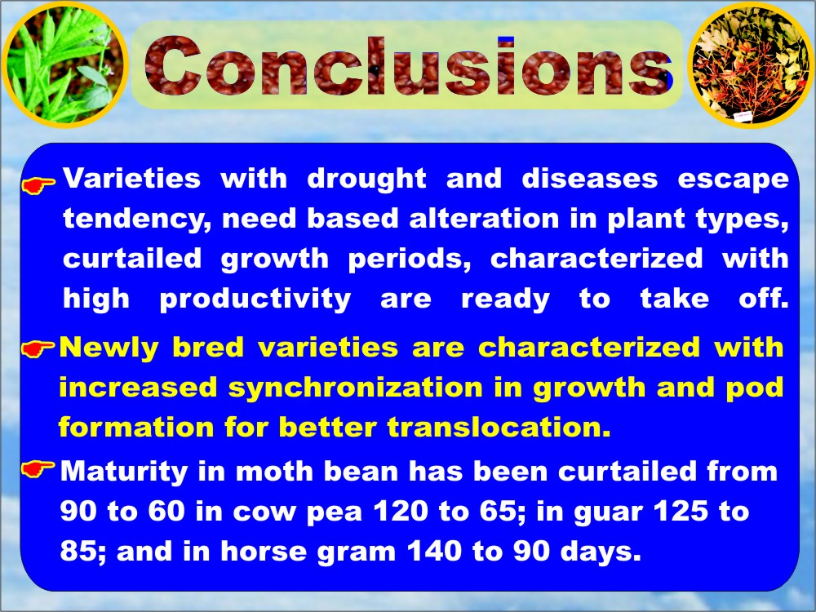
Notes:
27

Slide 28
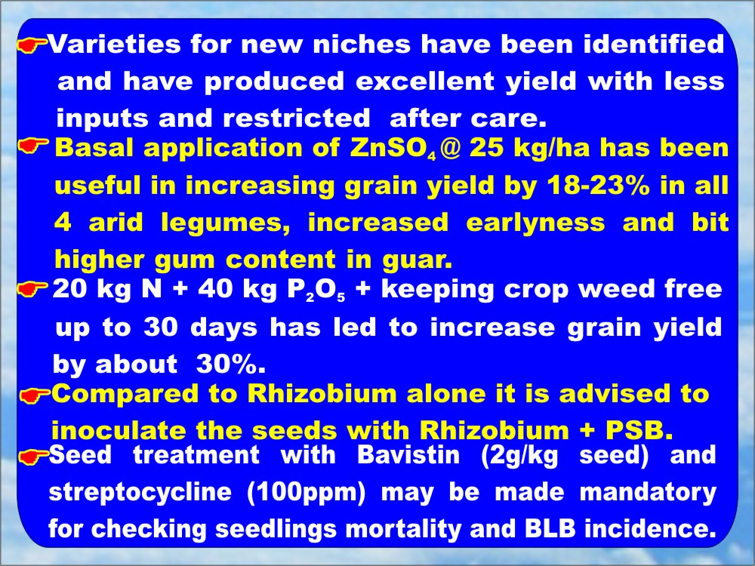
Notes:
28

Slide 29
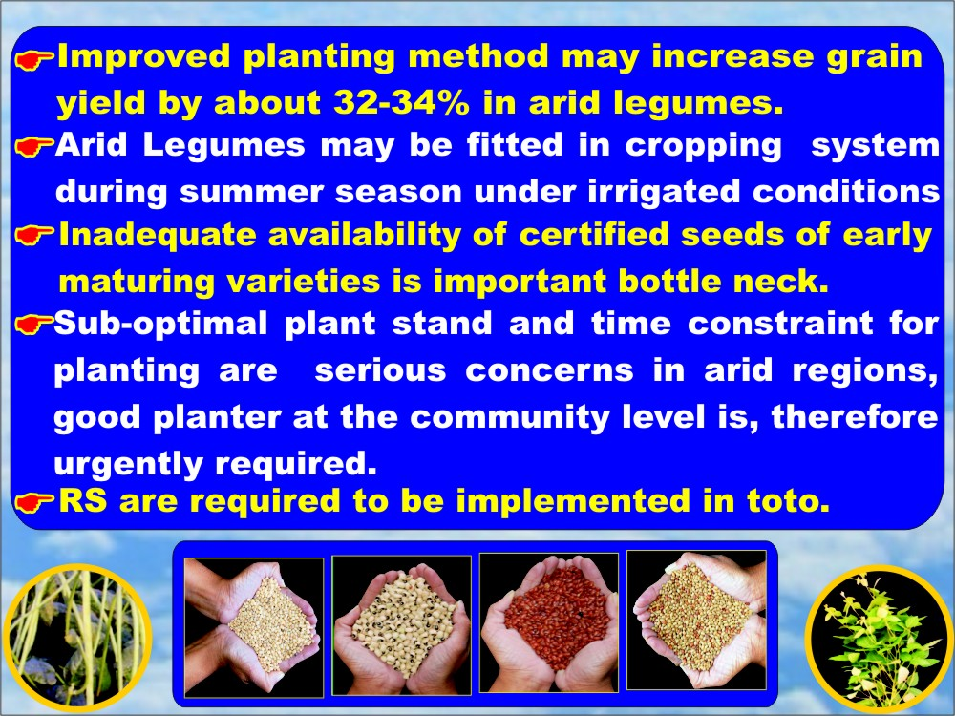
Notes:
29

Slide 30

Photograph with some Asian delegates& VIPs

Slide 31
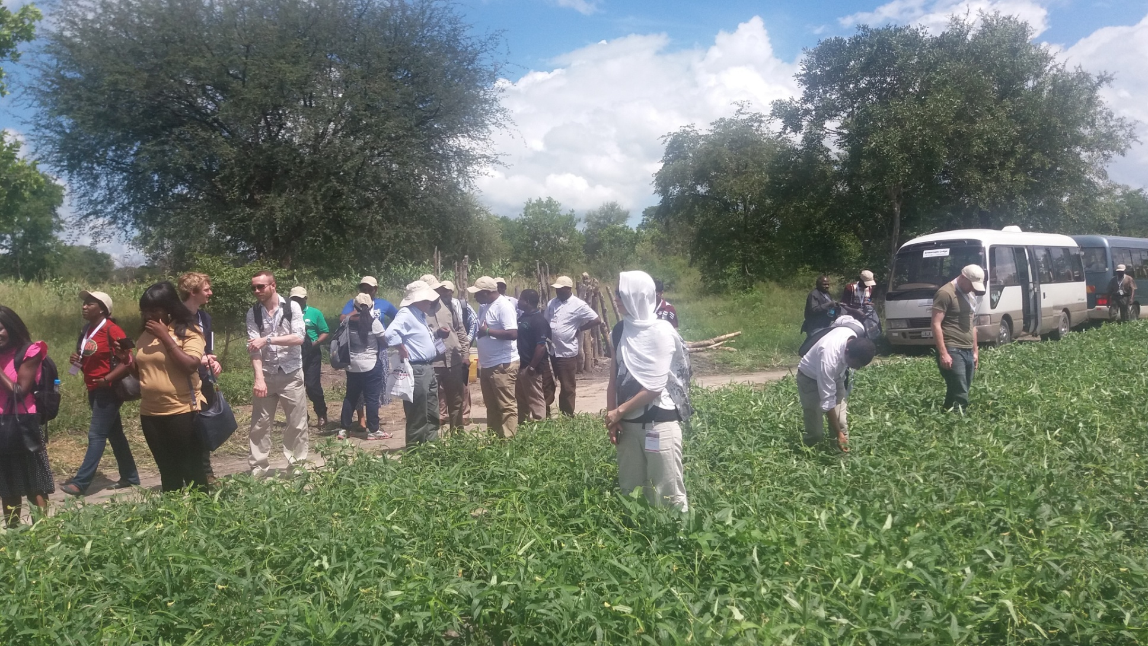
Field visit to cowpea seed production on farmers field

Slide 32
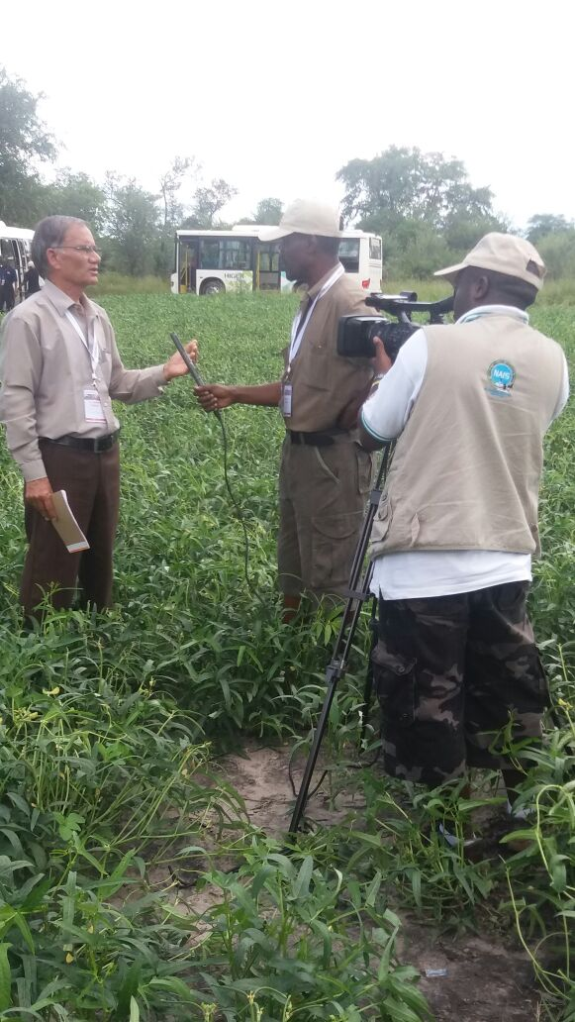
Interview recorded by local T V reporter

Slide 33
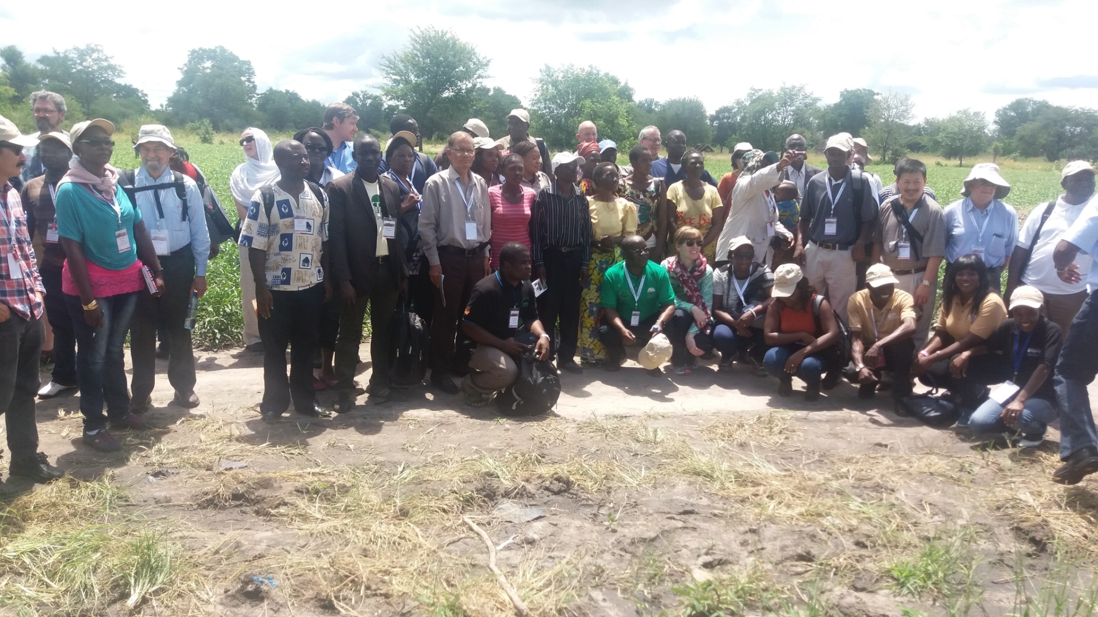
Trip to cowpea seed production field

Slide 34
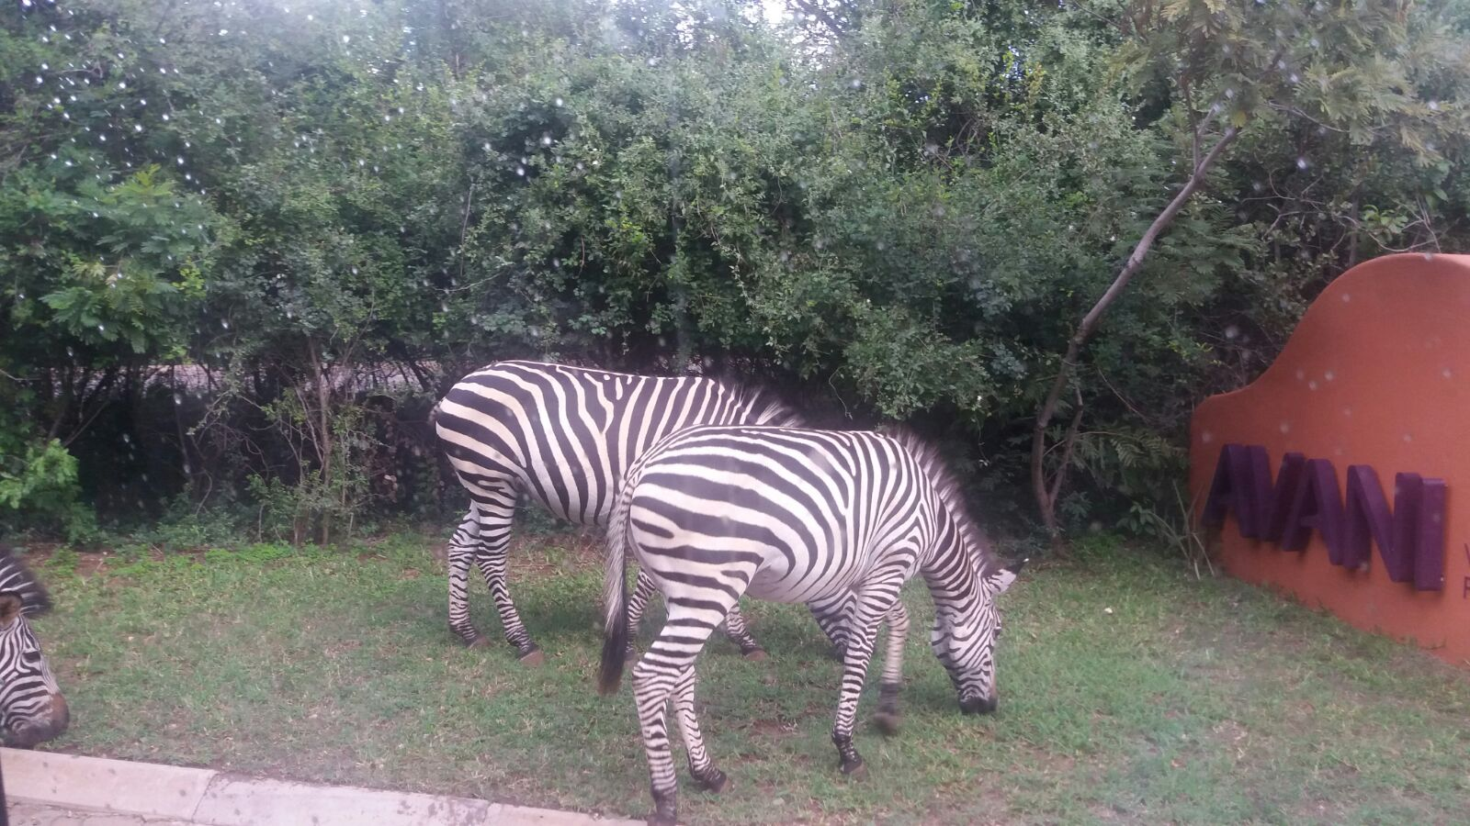
आप से मिलना , मान मेरा आप से बिछड़ना, अभिमान मेरा

